Slide 1

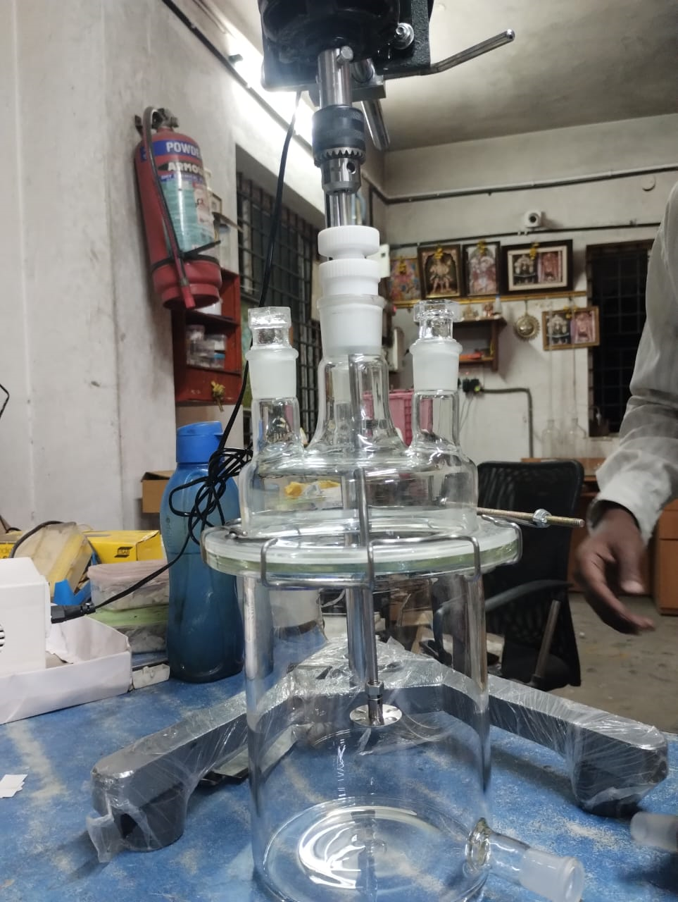
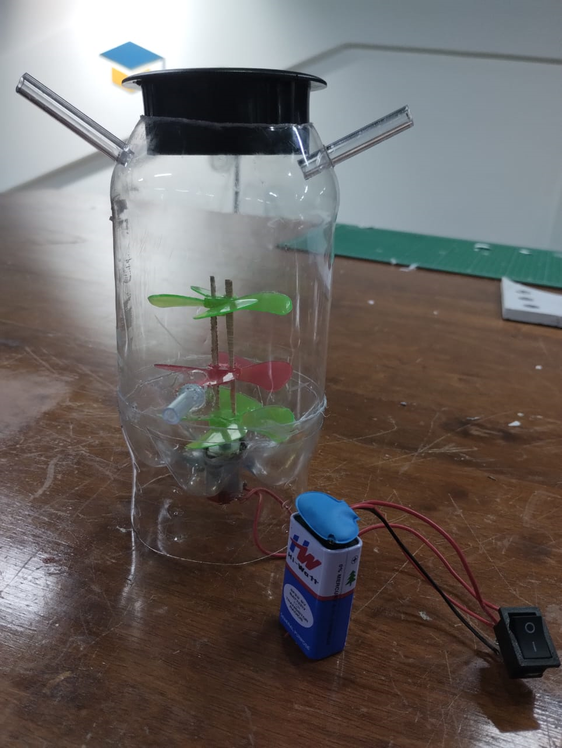
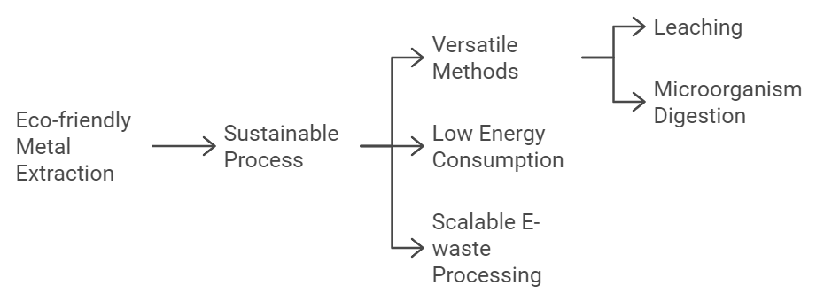
Team Name (Registered on Devfolio): Algo-Rhythms Theme: Open Innovation
University/Institute name: The Oxford College of Engineering City/state: Bangalore, Karnataka
Problem Statement Title: High Value Metal Extraction from E-waste using Microorganisms
Problem Statement: The rapid increase in e-waste disposal poses a significant environmental threat, with valuable metals often being lost in landfills and it contaminates the soil and water. The existing technology consumes high power and resources.
Our Solution: We extract valuable metals from processed
e-waste using microorganisms, enhancing energy efficiency and minimizing harmful environmental impact.
Uniqueness
Prototye Image
Sample Model

Slide 2
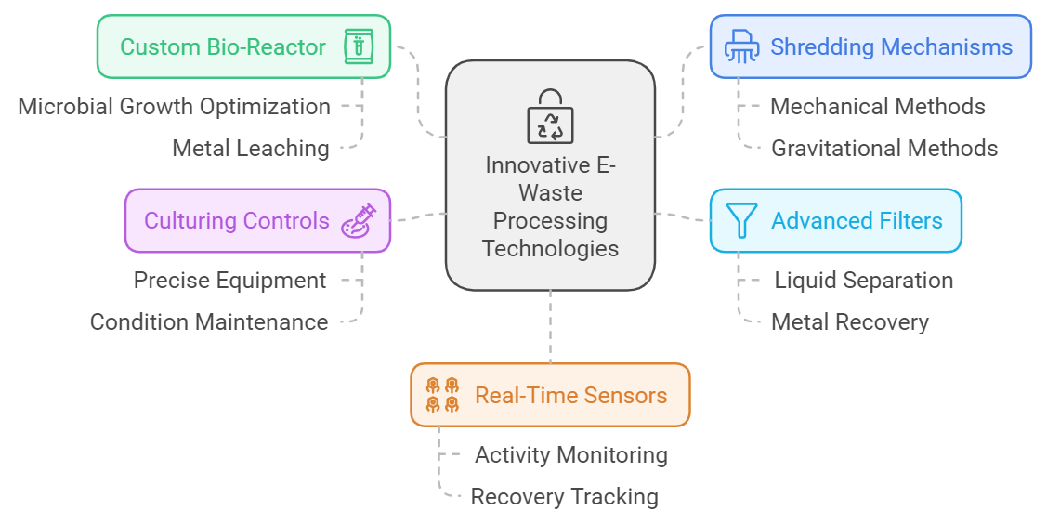
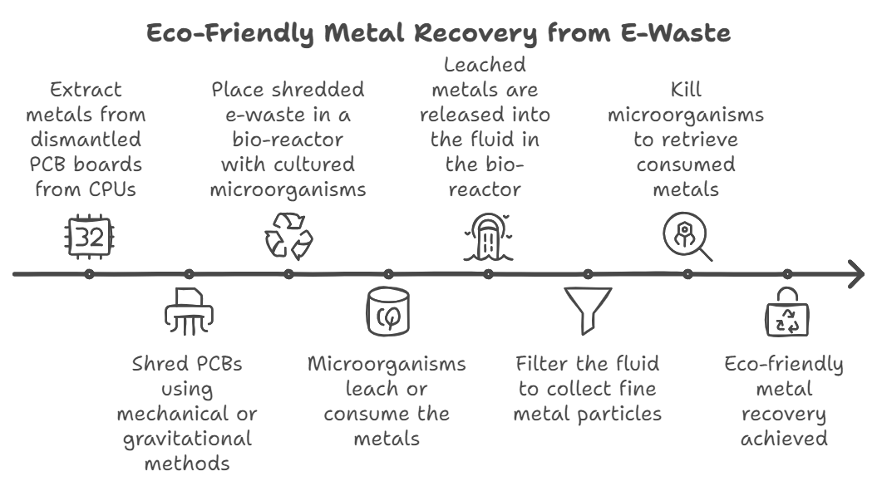
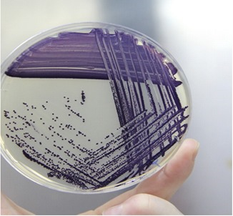
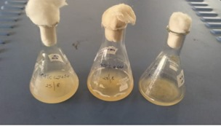
Algo-Rhythms
TECHNICAL APPROACH
Process
Technology Used
Tested and verified bacteria: CHROMOBACTERIUM VIOLACEUM
@DeVHack Idea submission- Template
3

Slide 3
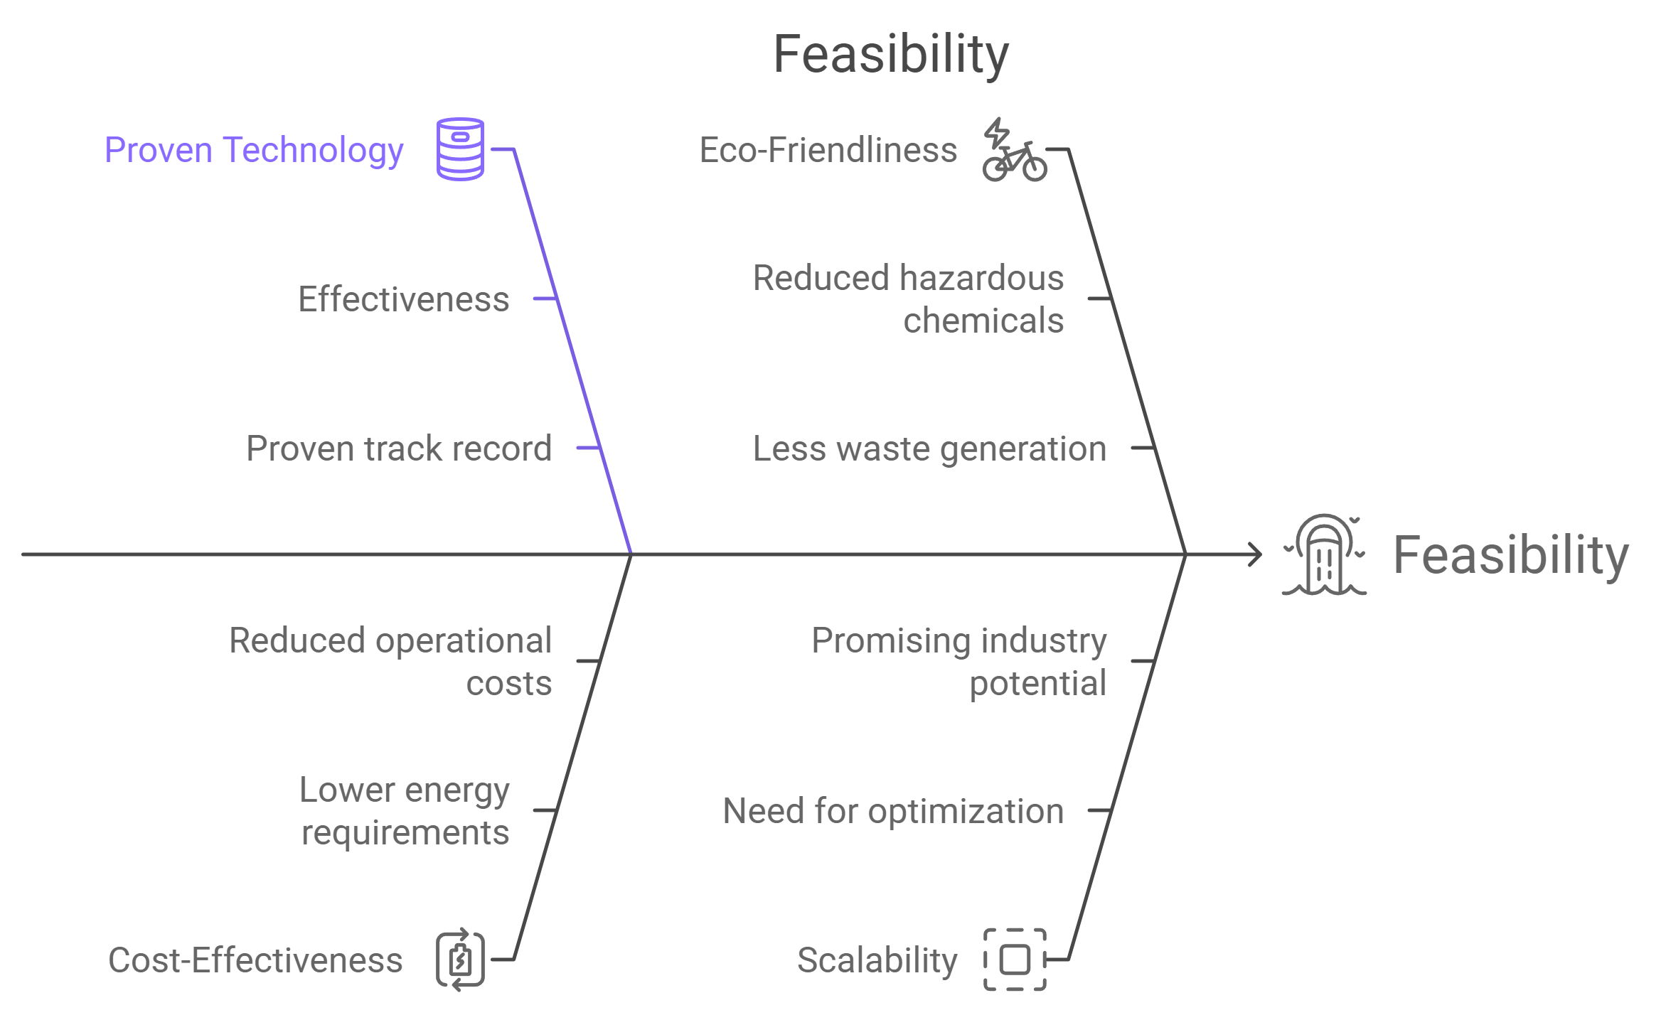
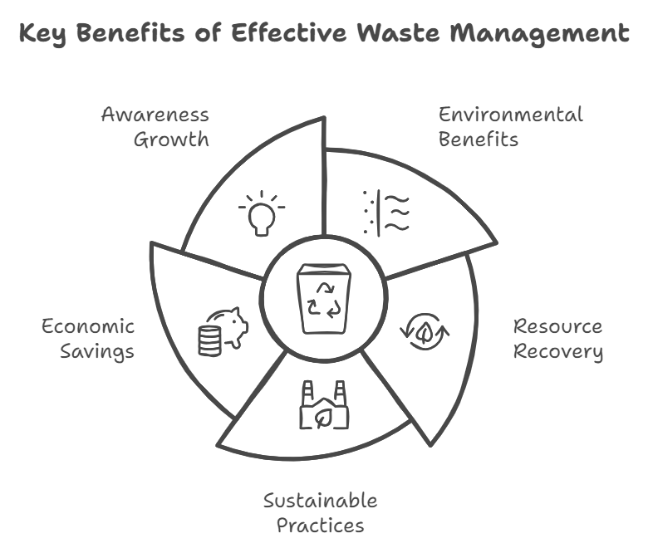

Algo-Rhythms
FEASIBILITY AND IMPACT
Impact
Potential Challenges and Risks
@DeVHack Idea submission- Template
4

